Slide 1

Creative Commons Update: OER, Policy,
4.0 & MOOCs
Dr. Cable Green
Director of Global Learning
Creative Commons

Slide 2

Except where otherwise noted, this work is licensed under:
http://creativecommons.org/licenses/by/3.0

Slide 3
Creative Commons
Refresh
Notes:
Here are some of the most important benefits and improvements to the licenses the OER and education community in particular can expect to see when the licenses launch late this year.

Slide 4





Notes:
CC is the law catching up with the way the internet actually works.

Slide 5
Step 1: Choose Conditions
Attribution
ShareAlike
NonCommercial
NoDerivatives
Notes:
can do this right at creativecommons.org via our license chooser
step 1 is to choose the conditions that you want to attach to the work
all cc licenses require attribution to the original author of the work
after that users can decide which conditions they want to apply

Slide 6
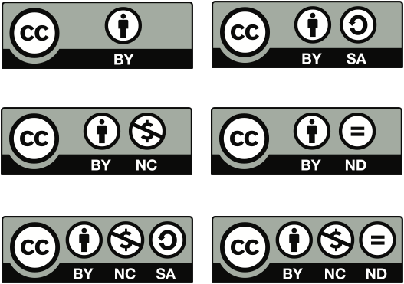
Step 2: Receive a License
Notes:
step 2 is to simply receive the license
there are 6 CC licenses that reflect a spectrum of rights
for the photos I share on Flickr, I use the Attribution only license, which means that anyone can download, copy, distribute, remix, tweak, and build upon them, even commercially, as long as they give me credit

Slide 7







most free
least free
Notes:
7

Slide 8
Open Educational Resources
Refresh

Slide 9
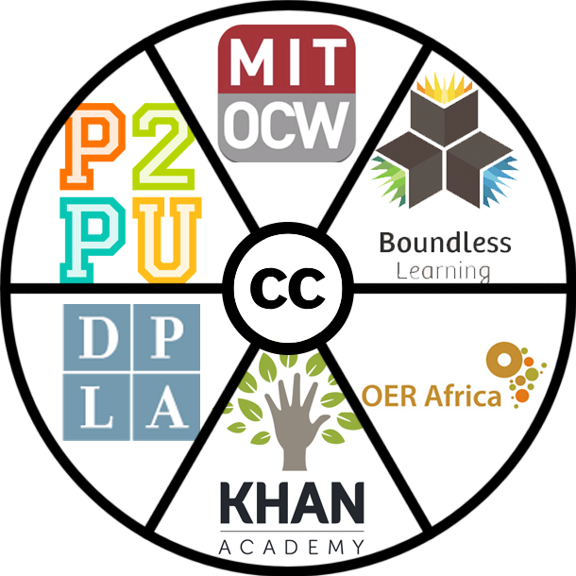
Open Educational Resources (OER)

Slide 10
OER are teaching, learning, and research materials in any medium that reside in the public domain or have been released under an open license that permits their free use and re-purposing by others.
Notes:
Open license is key.
Free as in free beer and free as in freedom

Slide 11
MOOCs:
Free vs. Open
Affordable, Free, Open

Slide 12
CC 4.0
Notes:
Here are some of the most important benefits and improvements to the licenses the OER and education community in particular can expect to see when the licenses launch late this year.

Slide 13



What You Can Expect
Clarified, more flexible, still respectful;
Easier compliance for teachers, students
ShareAlike as before, no expansion
No change in definition;
No disruption of existing sharing models
Notes:
Attribution requirements have been aggregated and greatly simplified, with more flexibility built in such that all requirements are subject to a “reasonable to the means, medium and context” standard;
ShareAlike remains unchanged, which means your BY and BY-SA works can still be uploaded to Wikipedia/media as before, and you can remix content with your own from Wikipedia/media as before, with same rules SharingAlike applying
No change in NC – this is a relief for many and a disappointment for others, but no compelling case with substantial consensus emerged; for those in the education with models based on –NC, you can continue to rely on the same definition applying

Slide 14
Other 4.0 Features
    Automatic reinstatement upon cure
    Clear(er) that additional permissions always
    allowed by licenses
Notes:
Other improvements:
Reinstatement: A common complaint of many users of CC licensed works is that the automatic termination provision is harsh and ought be softened. 4.0 will include a provision that provides a path to automatic reinstatement of the license upon cure of a violation. This is common in other public licenses, and if included will facilitate the continued use of works by those who correct violations without the need for contacting the licensor directly. This will be particularly beneficial inadvertent violations involving attribution. As currently drafted, the license may be reinstated on the date the violation is cured, “provided it is cured within 30 days of Your discovery of the violation; or upon express reinstatement by the Licensor.”
Warranties: CC also recognizes that licensors may wish to express disclaimers and limitations differently than the default license provision. Reasons for this may include differences in their business models or risk portfolios, or because local laws contain special requirements. 4.0 will allow licensors to offer modified disclaimers, as well as to affirmatively offer warranties if they find that desirable.
Additional permissions. Finally, while always implicit in our licenses, we choose to make express in 4.0 that licensors may always offer their works under different terms and may always grant more permissions, or waive certain conditions, than the license already provides. This may be useful for educators who choose to use the –ND licenses but who want to offer the ability of others to translate their works, or for those who want to waive attribution without the need for giving written consent, which is the existing mechanism for doing so under 3.0 and prior versions.

Slide 15
What’s next?
    Final draft is published
    Launch! (imminent)
Notes:
Self-explanatory.
Links for photos:

Slide 16
Open Policy

Slide 17
Publicly funded resources should be
openly licensed resources.

Slide 18








Current research funding cycle does not maximize dissemination, economic efficiency, social impact
Government RFPs announced, research grants awarded
Scientific research conducted and papers written
Articles submitted to journals and peer review occurs
Acceptance in journals; authors transfer copyright to publishers
Articles published in mainly closed access journals
Slow scientific progress, poor return on public investment
Public granted little or no reuse rights beyond access to read articles
Libraries subscribe or public pays per article fee to view on publisher's website

Slide 19








Optimized research funding cycle maximizes
public access, economic efficiency, social impact
Government RFPs announced, open license requirements included, research grants awarded
Scientific research conducted and papers written
Articles submitted to journals and peer review occurs
Acceptance in journals; public access policy ensures deposit in open repository
Accelerated scientific progress, optimal return on public investment
Public granted full reuse rights under open licenses
Public can download articles from open access repository
Articles published in traditional journals under embargo

Slide 20



Current educational resource funding cycle does not maximize dissemination, economic efficiency, social impact
Government RFPs announced, education grants awarded
Educational resources produced
Peer review limited to grantee's institution
Copyright with grantee, no obligation to share
Content only used at grantee institution
Slowed learning, poor return on public investment
Public granted little or no reuse rights
Public does not know about education resources

Slide 21




Optimized educational resource funding cycle maximizes public access, economic efficiency, social impact
Government RFPs announced, open license requirements included, education grants awarded
Educational resources produced
Peer review broadened to education community
Copyright vests with grantee, all resources openly licensed
Accelerated learning, maximum return on public investment
Public granted full reuse rights
Public knows about education resources
Content used by grantee and beyond

Slide 22
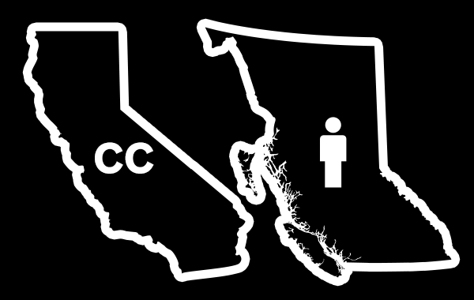

CC-BY licensed textbooks + OR + WA + 2 x Provinces

Slide 23

$500 million – Round 3
($2 billion over four years)

Slide 24


White House issues directive supporting
public access to publicly funded research
Notes:
White House Public Access Policy
policy introduced Feb 22, 2013
allowable embargo 12 months
19 federal agencies
agencies must coordinate and have plans in place by Aug 22, 2013
Effort to return scholarly publishing to its original purpose: to spread knowledge and allow that knowledge to be built upon.
John Holdren, Director of the Office of Science and Technology Policy, “has directed Federal agencies with more than $100M in R&D expenditures to develop plans to make the published results of federally funded research freely available to the public within one year of publication and requiring researchers to better account for and manage the digital data resulting from federally funded scientific research.”
---------------
Open Access FASTR
legislation introduced Feb 14, 2013
public access to publicly funded research after allowable 6 month embargo
federal agencies with extramural research over $100M/year
State level
California
passed Assembly, now debated in Senate
12 month embargo
Illinois
New York
OER
new U.S. GAO report shows textbooks becoming increasingly expensive (textbook costs to students at higher education institutions are rising 6% per year on average, and have risen 82% over the last decade). Openly licensed textbooks can be a piece of the solution.
California Senate Bill 520 - http://leginfo.legislature.ca.gov/faces/billNavClient.xhtml?bill_id=201320140SB520
This bill would establish the California Online Student Access Incentive Grant program. The bill would require the online courses supported by incentive grant funds to be placed in the California Virtual Campus. Online courses means educational materials that been released with an intellectual property license that permits their free use or repurposing by others.
Open Data
Obama Executive Order on Open Data
Project Open Data
Open licenses (aligned with Open Knowledge Definition) may be used by agencies for data outside of that in public domain under Section 105

Slide 25

California Community Colleges require
Creative Commons Attribution
for Chancellor’s Office Grants & Contracts
Notes:
At today’s meeting of the Board of Governors of the California Community Colleges, the Board voted unanimously to require open licensing on publicly funded materials resulting from all Chancellor’s Office contracts and grants.
http://creativecommons.org/weblog/entry/39457

Slide 26
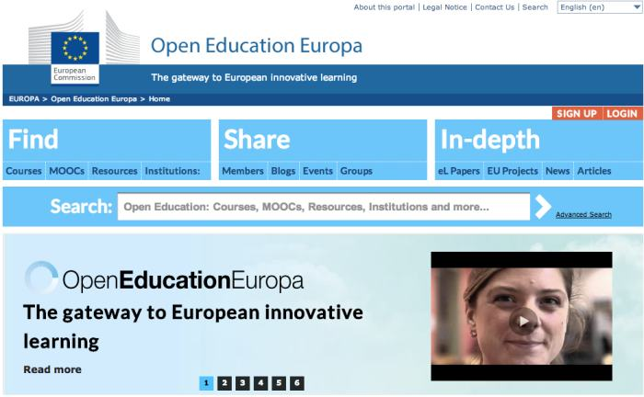

Slide 27
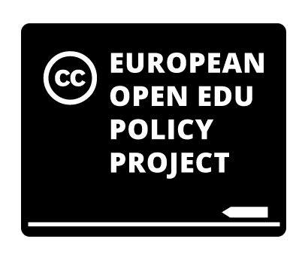
Notes:
"Open Educational Resources Policy in Europe" is a project that brings together a coalition of international experts to strengthen the implementation of open education policies across Europe. It aims to take advantage of the current high profile of open education in Europe, demonstrated by developments such as the explicit mention of Open Educational Resources (OER) as an important policy goal in the EU's new educational strategy "Opening up Education."
building a COMMUNITY of activists, in particular by bringing together CC affiliates and others in their networks involved in OER activities;
creating CONTENT ­ a policy position and analyses to support it, as well as outreach and educational materials, in particular a handbook explaining the operation and benefits of open education; and
establishing CONTACT with policymakers and other key stakeholders through a series of targeted meetings and workshops.

Slide 28
Open Policy Network

Slide 29
openpolicynetwork.org oerpolicies.org

Slide 30
Support ALL Open Policy opportunities.

Slide 31
Open Policy Network supports the creation, adoption and implementation of open policies around the world by: mapping the open policy space across open sectors; identifying open policy gaps and opportunities within and across sectors;

Slide 32
communicating the social and economic value of open policy;
networking together those trying to develop open policies with organizations, communities and individuals who have open policy expertise; and
curating case studies and open policy exemplars for others to use or adapt.

Slide 33
Institute for Open Leadership

Slide 34
School of Open
Notes:
Here are some of the most important benefits and improvements to the licenses the OER and education community in particular can expect to see when the licenses launch late this year.

Slide 35
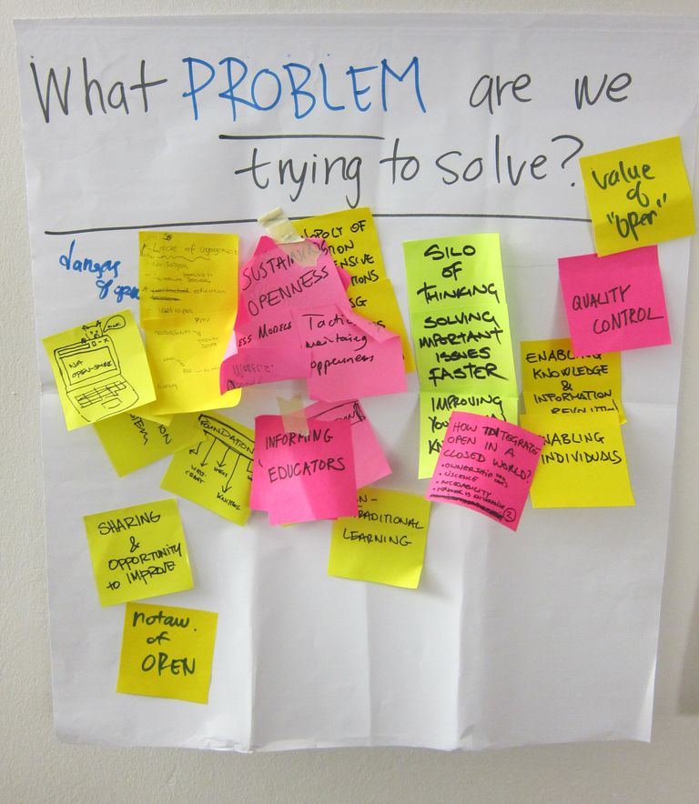
Notes:
Universal access to and participation in research, education, and culture is made possible by openness, but we are nowhere near universal access.
There are many movements promoting openness around the world, such as Open Source Software, Open Educational Resources, and Open Access… but they are not widely known among the people actually teaching, researching, and creating culture.

Slide 36
Open resources can improve access to and participation in research, education, technology, and culture...
But not enough people know what “open” means or how to apply it.
Notes:
The problem: Open content, tools and processes can vastly improve access to and participation in research, education, technology, and culture, but not enough people know what "open" means or how it applies to their lives.
The solution: Peer learning on what "open" means and how to use open content, tools, and processes powered by peer mentors and learners, self-organized into courses which themselves leverage existing "open" learning materials.
The goal: Encourage everyone, including artists, educators, learners, and researchers, to improve their fields through the use of open content, tools, and processes. Provide opportunities to obtain skills and certification around open practices that result in improved access to and participation in research, education, technology and culture.
The School of Open will help people by developing and offering online courses, free and open to anyone to take.

Slide 37
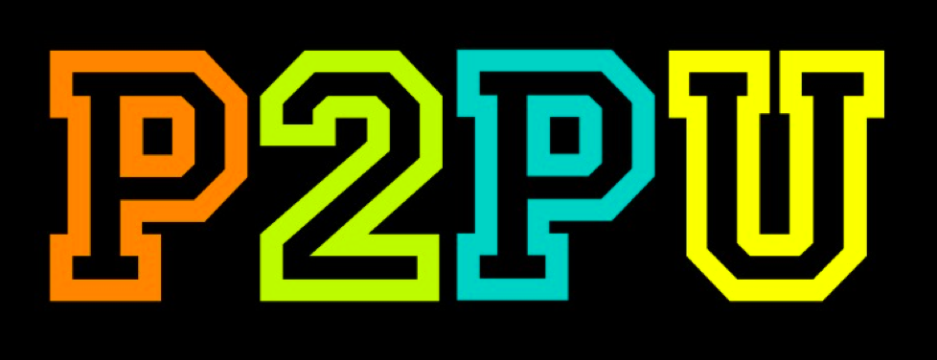

Notes:
The School of Open is foremost a collaborative initiative being led by community of volunteers, but the community is coordinated by two organizations -- the Peer 2 Peer University, or P2PU, and Creative Commons.
P2PU is an active peer learning platform and community for developing and running free online courses. Volunteers, individual creators and organizational representatives, can design courses for peer learning in study groups or for facilitation by a subject expert.
Creative Commons is a globally focused nonprofit dedicated to making it easier for people to share and build upon the work of others, consistent with the rules of copyright.

Slide 38
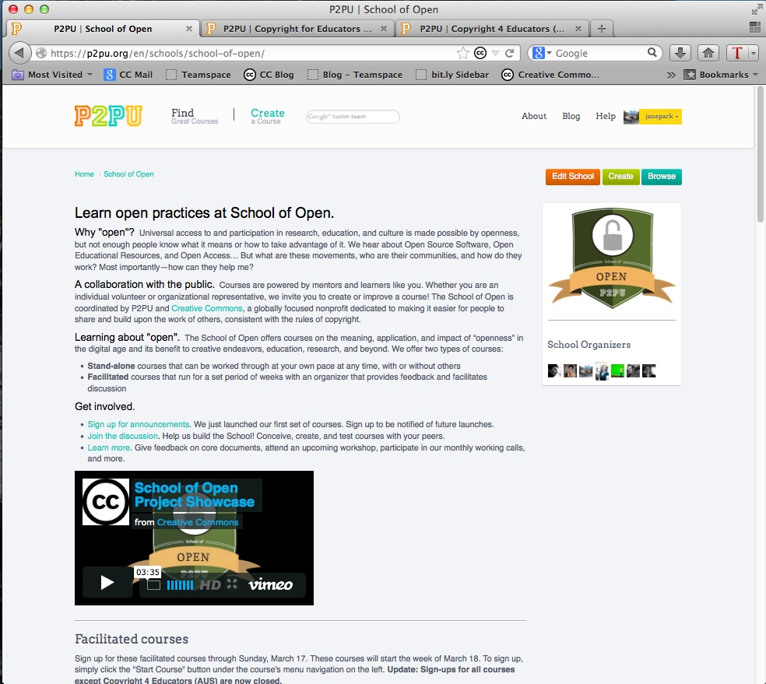
Notes:
While P2PU encompasses all types of courses, the School of Open is focused on the specific domain of openness.
SOO officially launched during Open Education Week (March 11-15, 2013) with 17 courses.

Slide 39
Go: http://schoolofopen.org
Join our discussion list & introduce your interest
Help build and run a course in your language
Take a course!
Notes:
How you can get involved in the School of Open effort:

Slide 40
You can also:
1. Run a workshop
2. Use School of Open curriculum in your school course or training
3. Volunteer translation, graphic design, peer review, or other skills!

Slide 41
schoolofopen@p2pu.org
Notes:
The best way to get involved is to join our Google Group, but if you have private questions, email the Project Manager at schoolofopen@p2pu.org

Slide 42
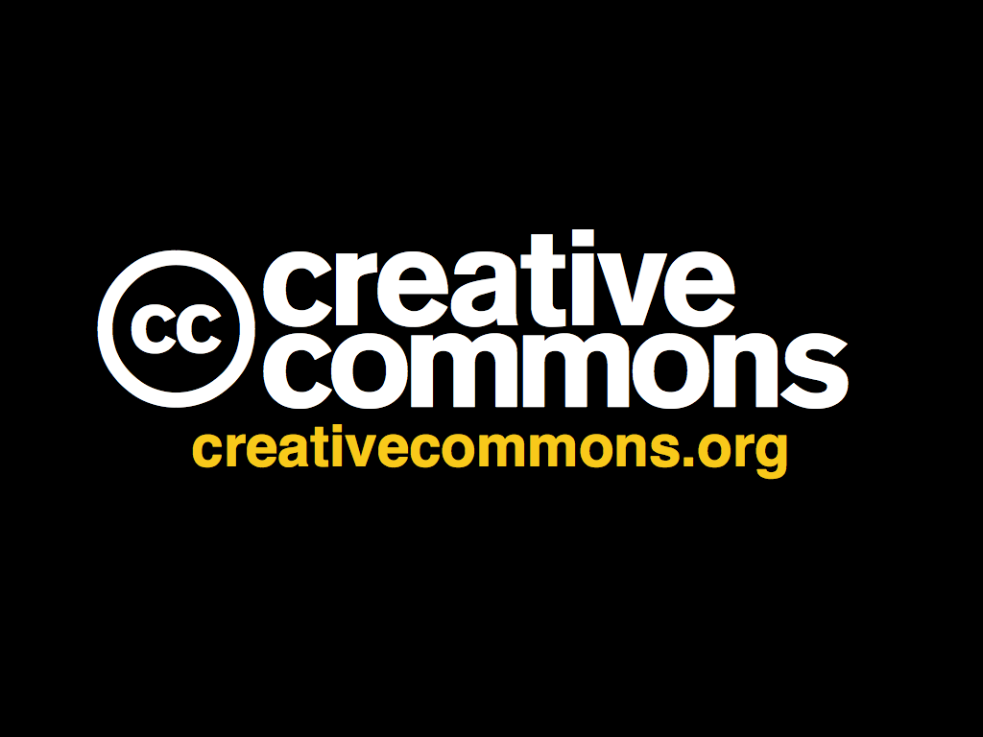

Notes:
Creative Commons and our open colleagues around the world stand with Alberta as you engage these topics.

Slide 43
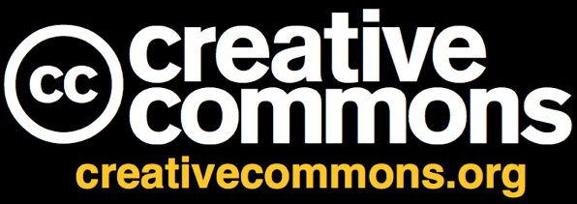
Dr. Cable Green
Director of Global Learning
Notes:
Thank you.

